Slide 1
WFRC/MAG Travel Model Version 7
What’s New since Version 6
Prepared for:
WFRC, MAG, UTA, UDOT

Slide 2
Outline
Changes to file structure & model flow
Changes to inputs
Changes to individual models
Validation results
Recommended next steps

Slide 3
Outline
Changes to file structure & model flow
Changes to inputs
Changes to individual models
Validation results
Recommended next steps

Slide 4
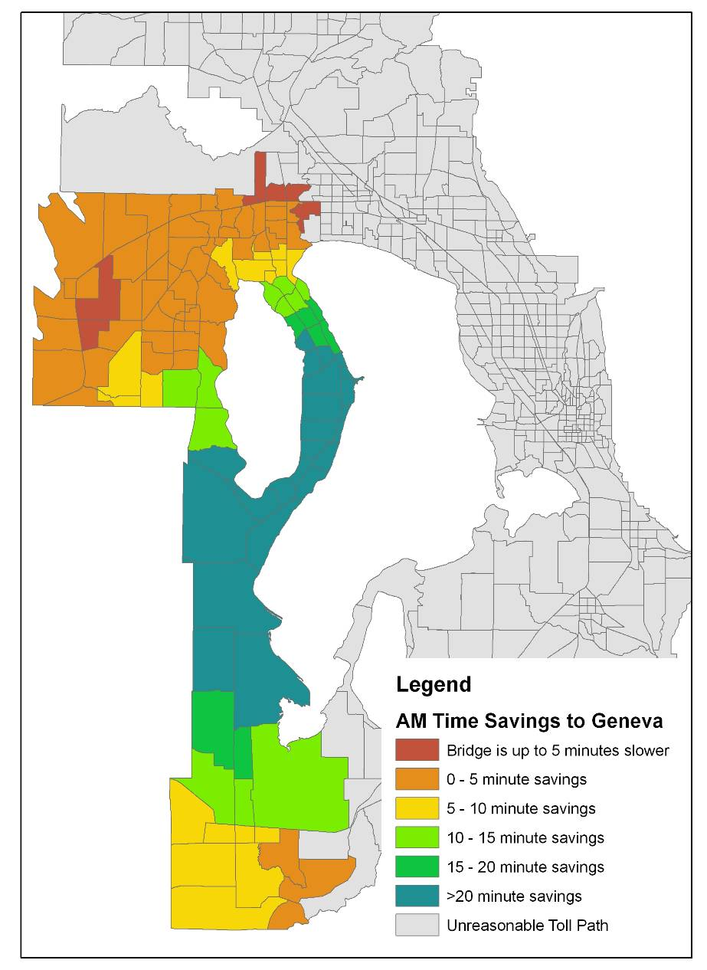
Model Version 7 Changes
2+ year effort
New TAZ and networks
New SE data
New “Front End”
Input Processing
Minor Changes to Trip Generation
Trip Distribution
Transit Path-finding
Mode Choice
Traffic Assignment
Managed Lanes Forecasting
Validation & Reasonableness Checking

Slide 5
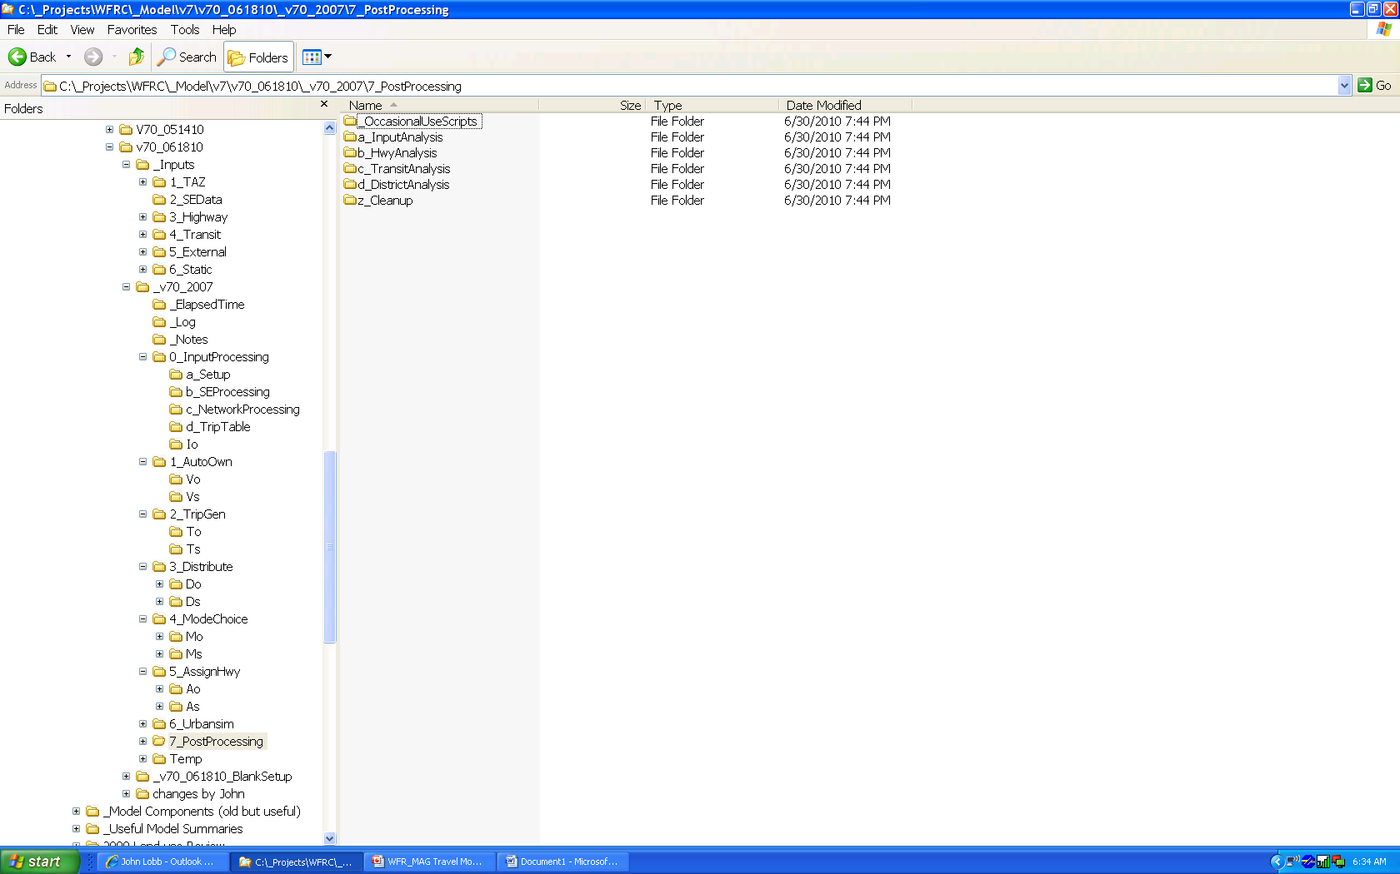
Directory Structure
Directory Structure
  _Inputs
  MODEL
    _ElapsedTime / _Log / _Notes
    0_InputProcessing
    1_AutoOwn
    2_Tripgen
    3_Distribute
    4_ModeChoice
    5_AssignHwy
    6_Urbansim
    7_PostProcessing
    Temp
Inputs directory location is the most notable change (outside the model).

Slide 6
New Front End – Input Directory
Input Directory
  Kept outside of the model scenarios
  Reduces duplicate information (a little)
  Easier to keep track of variations of key inputs
Static Directory Stores
  External: IXXI, XX Tables
  TripTables: College, Airport & Lagoon Control Total & Base Year Distribution
  AutoOwn: HH Disaggregation Lookup Tables
  TripGen: Parameters Related to Geography

Slide 7
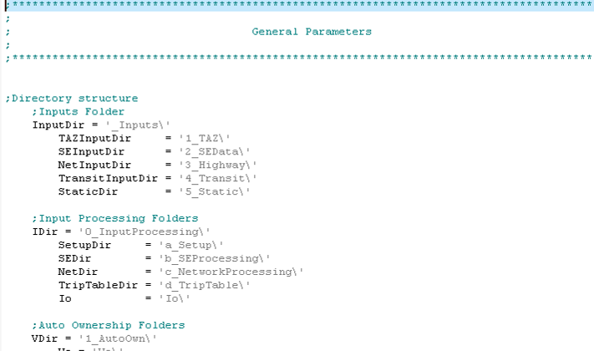
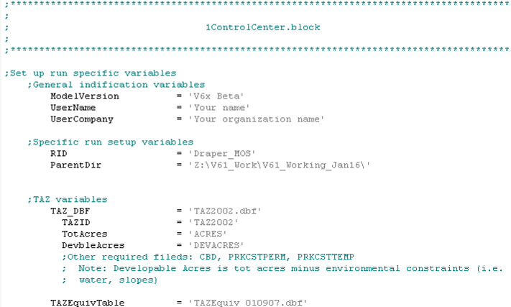
Control Center Files
0GeneralParameters.block
  General or Global Variables
  Not Modified Often
  Care Needed When Updating
  .block Extension For Syntax
  Highlighting
1ControlCenter.block
  Scenario Specific Variables
  Allows User to Focus on
  Relevant Data

Slide 8
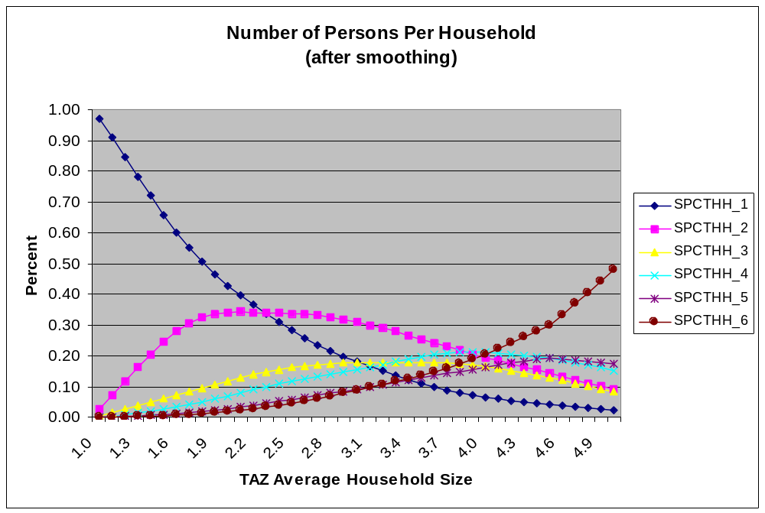
New Front End – Input Processing
Processes that are now internal to model
College, Airport, Lagoon Trip Table Forecasting
Emp30MinTransit & Walk Access Links Moved Up Front
HH Disaggregation Script

Slide 9
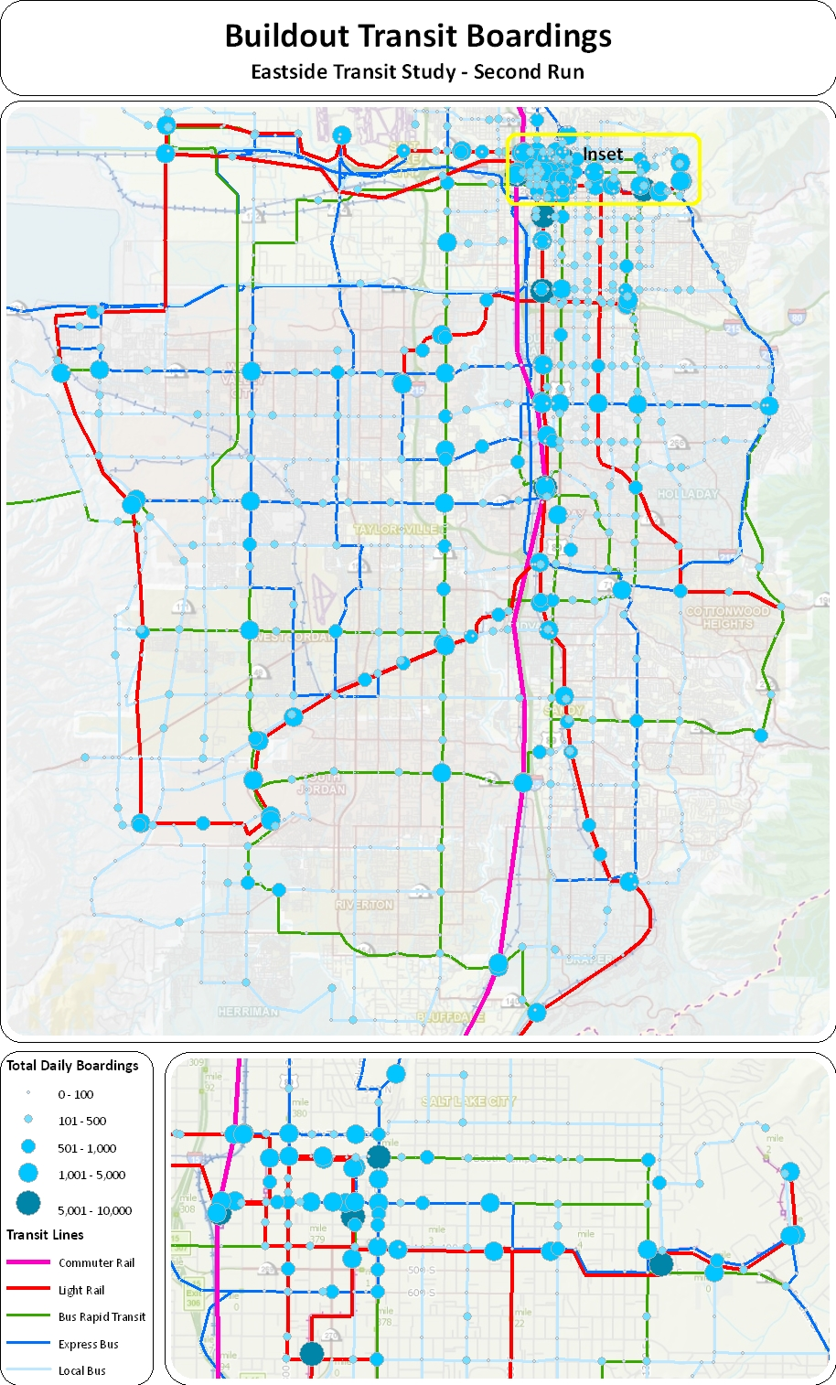
New Outputs
Log files
  Front-end log files stored in _Log directory
  Detailed summaries of input processing scripts
“Warnings” on scenario network
  Indicates network and SE values that may be outliers or may be unreasonable
Transit boardings summary
  \4_ModeChoice\Mo\Boardings\
  Aggregation of model boardings and network operational statistics by station, route and mode in separate files
  Allows for easy mapping of transit boardings

Slide 10
Outline
Changes to file structure & model flow
Changes to inputs
Changes to individual models
Validation results
Recommended next steps

Slide 11
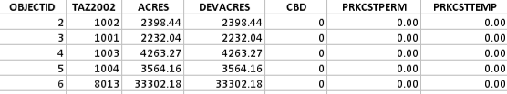
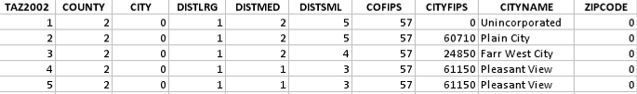
Inputs – TAZ Files
New TAZ Structure
  Ranges need not be consecutive
  RegionRange = '1-2250‘
  WeberRange = '1-283' ;includes externals
  DavisRange = '284-502‘
  SLRange = '503-1632' ;includes externals
  UtahRange = '1633-2250' ;includes externals
  dummyzones = '2251-3400'
TAZ Shapefile
Equivalency File

Slide 12
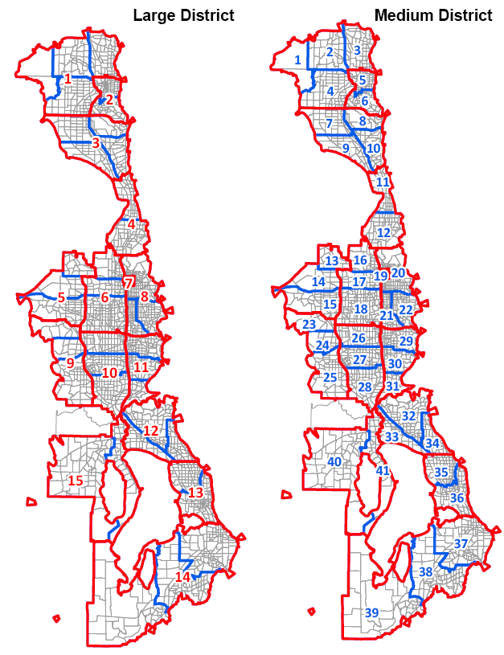
Inputs - Districts
Minor changes to the district structure
Districts were renumbered with v7

Slide 13
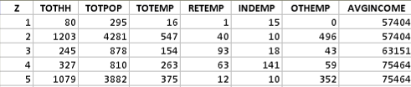
Inputs – Socio-Economic File
SE File Changes
  No HH1 - HH6 Fields (Calculated in HH Disaggregation Step)
  No HHSIZE Field (Calculated in HH Disaggregation Step)
  No TOTDWL Field
NOTE that HH DISAGGREGATION is internal to the model now (i.e. no off-model “Gliebe process”

Slide 14
Inputs - Highway Network (update)
Highway Network Link and Node Field Name Changes
  STREET_N -> STREETNAME
  TAZ2002 -> TAZID
  TAZ02 (node) -> TAZID
  new node variable -> Seamless Transfer
  There is no longer area type exception (the network was too cluttered with 3 exceptions)
Required Fields
  NODES
  LINKS
  Use ID Field to Update Other Field Data (e.g. TAZID Used to Update County, City, Districts)
Updated By Hand
pnr_field
SeamlessXfer
Updated By GIS
TAZID
Updated By Hand
LNfield
FTfield
HOVmarker
SPDEXCEPT
CAPEXCEPT
DISTEXCEPT
Updated By GIS
STREETNAME(text)
STATERD
TAZID

Slide 15
Inputs - Highway Network 2 (update)
Special notes about the highway network
  SPDFAC & CAPFAC
  Be aware of validation fields when copying links to edit a network.
    Speed data
    Count data
    HPMS_ID
    Peak % data
  TAZ02 (node) -> TAZID
  new node -> Seamless Transfer
It will likely take a few months of extensive use to find any remaining errors.
Work with consultants to bring appropriate changes back to network.

Slide 16
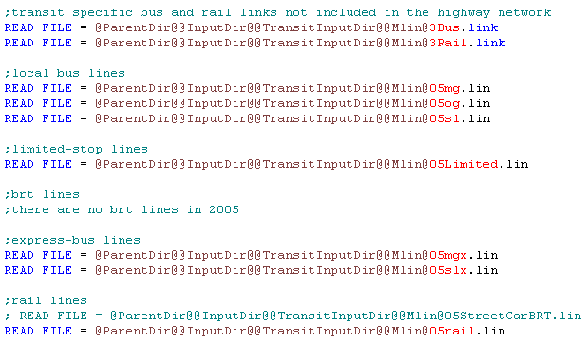
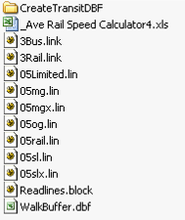
Inputs – Transit Network (update)
Readlines.block
  ‘3readlines.txt’ renamed ‘Readlines.block’
  ‘3readlines_ShapeFile.txt’ Removed
  .block Extension For Syntax Highlighting
Deleted Extraneous Files
  Trnfiles.txt Files
  05sll.lin (called but no data in file)
CreateTransitDBF Folder
  Files Used to Update Transit Buffers
_Ave Rail Speed Calculator4.xls
  Reminder to Update 3Rail.link File
  Scenario Specific Data Stored

Slide 17
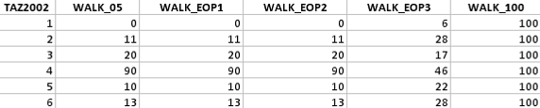
Inputs – Transit Buffer
Walk Buffer
  Moved to Transit Lin File Directory
  Store Scenario Specific Data or Multiple Field Database (Field Name for TAZ & Buffer Definitions Referenced in Control Center)
Methodology Changed
  Used Max Overlay Perimeter of All Buffered Areas
  Now Consider Each Buffer Independently
  Take Largest Buffer Area
  Still Use:
  0.4 Mile Buffer Around Line For Local Bus Mode
  0.4 Mile Buffer Around Stop For All Other Modes

Slide 18
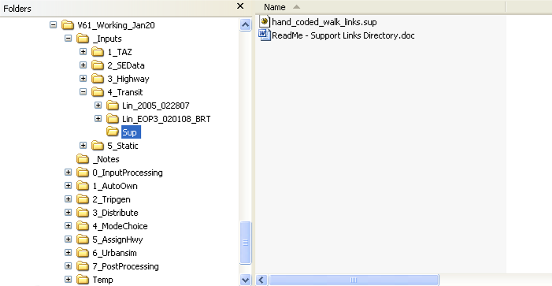
Inputs – Transit Hand-Coded Support Links
Hand Coded Walk Access/Egresss Links (Mode 12)
  Moved To ‘_Inputs\4_Transit’ Directory
  Reminder to Update
Hand Coded Drive Access Links (Mode 40/50/60/70/80)
  Currently used to ensure access to multiple light rail lines (mode 70)

Slide 19
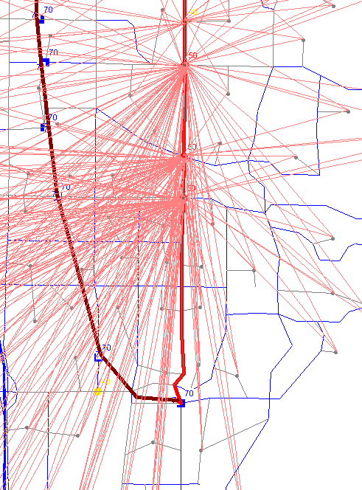
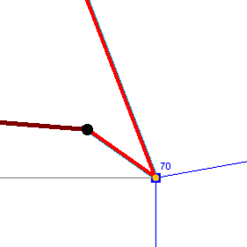
Inputs – Transit PNR Links
PNR Coding Conventions
  Transit stop must be coded at park & ride node for Drive Access Links to be drawn. It is recommended that buses stop directly at rail nodes too.
  Model doesn’t restrict Drive Access by PNR Type
  Drive Access Links automatically generated based on mode-specific access time thresholds & number of links per zone
  Keep in mind that the model probably generates too many drive links

Slide 20
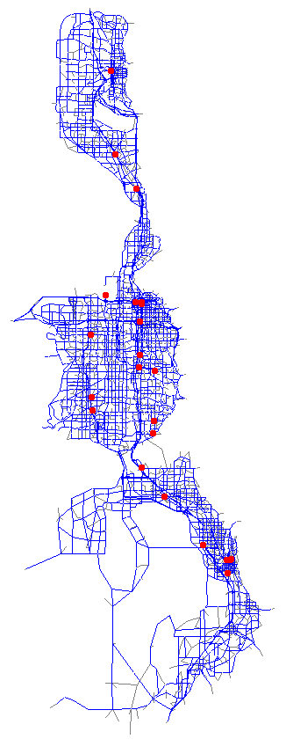
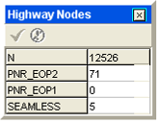
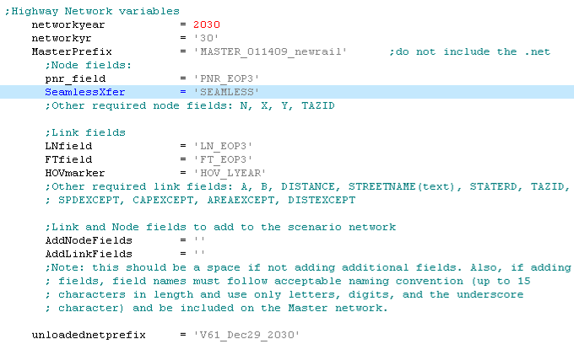
Inputs – Seamless Xfers
Seamless Transfers Coding
  Coded Onto Highway Network Nodes
  Value Coded Represents Number Of Minutes To Wait
  Field Name Identified in Control Center
  Easy to Visualize & Update
  Use judiciously

Slide 21
Outline
Changes to file structure & model flow
Changes to inputs
Changes to individual models
Validation results
Recommended next steps

Slide 22
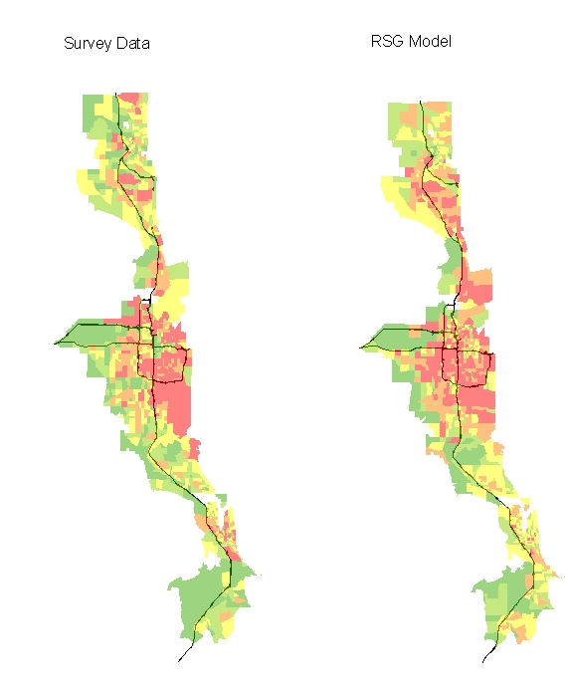
College/Airport/Lagoon Trip Tables
Home-based College Trips
  Total enrollment estimated for each college in FTE’s
  Base year trip tables derived from survey data
  Future year increment to trip tables forecasted using regression models estimated using observed student addresses
  Use ITE trip generation rate for non-HBC and non-work trips to colleges (i.e. ITE - HBC – HBW equals HBO/NHB/COMM)
Airport Trips
  Base year trip tables derived from survey data
  Regression model based on 1995 survey data
  Estimated separate models for resident (varies by income) and non-resident trips (varies by employment type)
LagoonTrips
  Implemented spreadsheet process
  Trips a function of distance
Airport Trips
more details:
_Inputs\6_Static\0_TripTables\

Slide 23
Trip Generation
Minor Changes to Trip Generation Script
  Modifications to trip attraction equations
  Removed a few miscellaneous factors that had grown stale
  HBWa[z] = RETEMP[z]*1.0 + INDEMP[z]*1.0 + OTHEMP[z]*1.0 + TOTHH[z]*0.0
  HBOa[z] = RETEMP[z]*11.8 + INDEMP[z]*0.0 + OTHEMP[z]*1.7 + TOTHH[z]*1.0
  NHBa[z] = RETEMP[z]*6.6 + INDEMP[z]*0.8 + OTHEMP[z]*1.0 + TOTHH[z]*0.6
  COMMa[z] = RETEMP[z]*0.5 + INDEMP[z]*1.3 + OTHEMP[z]*0.3 + TOTHH[z]*0.1
  HBWa[z] = RETEMP[z]*1.2 + INDEMP[z]*1.2 + OTHEMP[z]*1.2 + TOTHH[z]*0.0
  HBOa[z] = RETEMP[z]*5.4 + INDEMP[z]*0.0 + OTHEMP[z]*0.2 + TOTHH[z]*1.8
  NHBa[z] = RETEMP[z]*7.2 + INDEMP[z]*1.2 + OTHEMP[z]*0.7 + TOTHH[z]*3.5
  COMMa[z] = RETEMP[z]*0.5 + INDEMP[z]*0.3 + OTHEMP[z]*0.3 + TOTHH[z]*0.4
Commercial Vehicles
  Modified trip generation and trip distribution parameters to be generally consistent with the FHWA Quick Response Freight Manual
  Have not validated results against counts

Slide 24
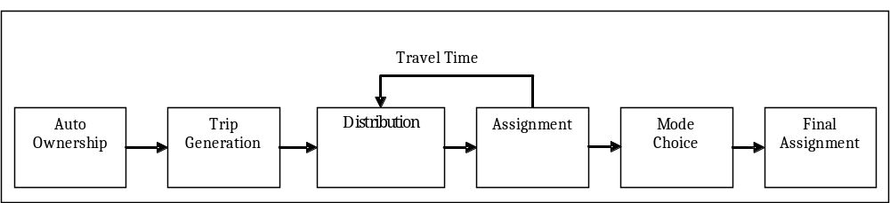
Trip Distribution
Changed the impedance value from time only to a function of time, distance and toll cost (if applicable)
impedance (minutes) = time +
distance * 13 cents/mile * (value of time) +
cost * (value of time)
value of time = 16 cents/min = $9.60/hour
Goal was to use same path-finding function in distribution and assignment. This required changes to the friction factors.

Slide 25
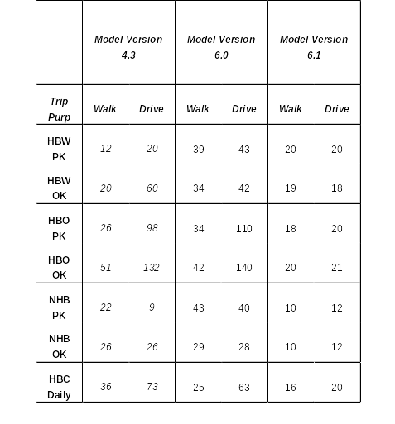
Mode Choice
FTA was uncomfortable with aspects of v6.0
  Rail vs. bus constants
  Transfer penalties (15-20 min)
  Drive time weights (2.5 X)
UTA revised its LRT counts
Revised based year employment
Revisited trip attraction equations (needed more HBO attractions in downtown)
Examined network coding
Library as spec gen
Revamped access link generation & buffers

Slide 26
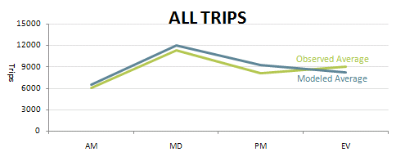
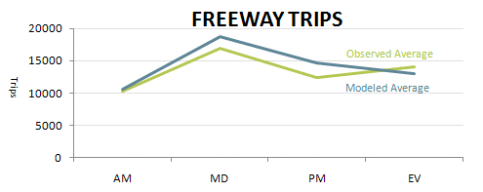
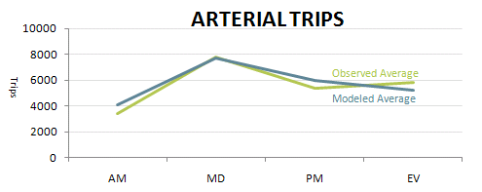
Distribution & Assignment - Peak Period Validation
Review of the Base Model
Based Year Model Review
 | All Roadways | Freeways | Surface Streets
AM | M ≈ O | M ≈ O | M > O
MD | M ≈ O | M > O | M ≈ O
PM | M > O | M > O | M > O
EV | M < O | M < O | M < O
M = Modeled Volume O = Observed Volume
Conclusion:
The old model (v6 and prior) had a tendency to overestimate traffic during periods of higher volume—the morning through the early evening--and underestimate traffic during periods of lower volume—at night.

Slide 27
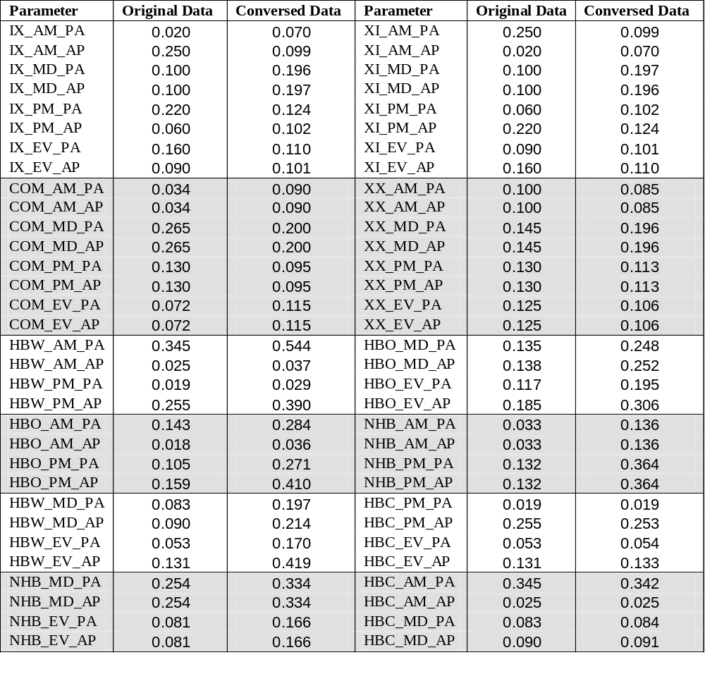
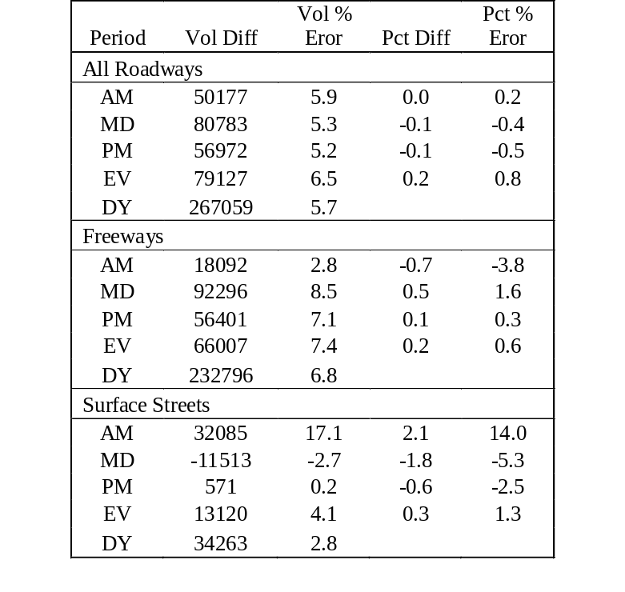
Distribution & Assignment - Peak Period Validation
Recommended Model Calibration
Model Improvement:
To improve the quality of model, RSG made minor adjustments on proposed time-of-day assumptions of the NHTS model.
Recommended Model Results

Slide 28
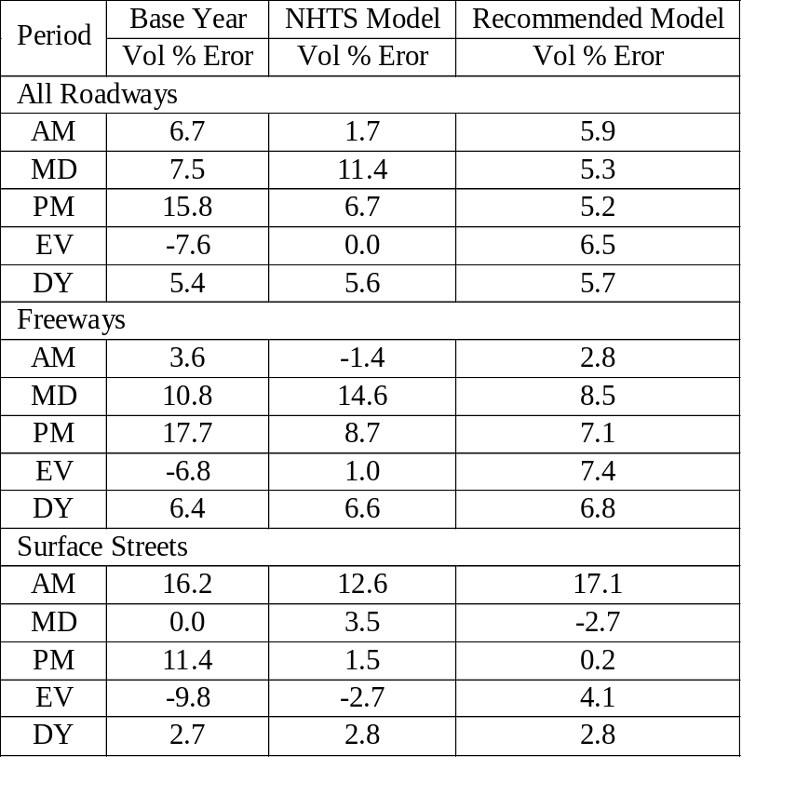
Distribution & Assignment - Peak Period Validation
Peak Period Validation:
The recommended model provides more reasonable trip volumes in each peak period than the NHTS model and the original model does, especially for trips during middle peak. However, we were not yet able to improve the calibration on surface streets in the AM Peak.
In v7, overall traffic was lowered, but in v6 when this work was done all the time periods were more-or-less uniformly high by 5-6%.
Comparison between Three Models

Slide 29
Outline
Changes to file structure & model flow
Changes to inputs
Changes to individual models
Validation results
Recommended next steps

Slide 30
Sensitivity & Calibration Test
Sensitivity & Calibration Tests
  Add CRT (Ogden to SLC) & 3500 South BRT to 2005 Network
  2005 Peak Period Coefficient Changes
  Multiple Calibration Runs to Test Parameter Changes

Slide 31
Outline
Changes to file structure & model flow
Changes to inputs
Changes to individual models
Validation results
Recommended next steps

Slide 32
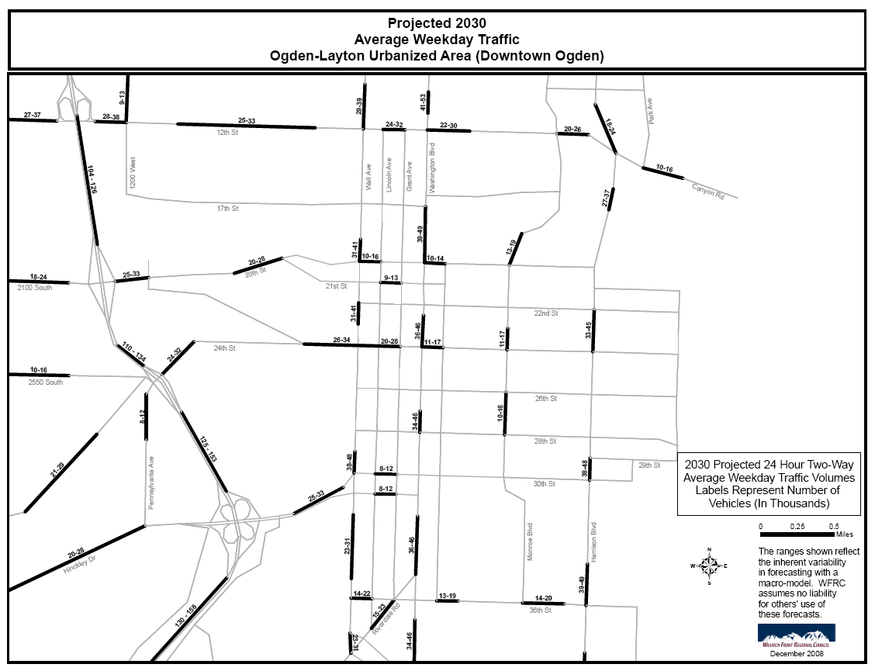

Slide 33
Prepared for:
WFRC, MAG, UTA

